Slide 1
^{8th} session.
Marketing Plan. Strategic Marketing. 4P's: Product and Place

Slide 2
Strategic Marketing. Segmentation and positioning.

Slide 3
Marketing
1.- Strategic marketing:
    Segmentation Strategy
    Positioning Strategy
2.- Tactical marketing or marketing Mix: The 4 P's. Product, Price, Place, Promotion.

Slide 4
Two strategic variables of marketing
SEGMENTATION
POSITIONING
Target audience
Product concept

Slide 5
Segmentation
“Process of division of the market in groups of consumers which have enough homogeneous needs and justify differentiated marketing actions in order to satisfy them as effectively as possible”.
Each segment can be reached by a concrete marketing strategy and tactic.
Segmentation allows identifying market opportunities and helps focusing on actions. Furthermore, it can suppose a differentiation factor with competitors. The main risk is to give “free spaces” to the competitors.

Slide 6
Segmentation example: New consumer
4,6%
15,2%
3rd age
well-off classes
7,9%
5,9%
3,1%
Adults
well-off classes
Lonely old people
14,1%
21,0%
11,5%
10,6%
Independents
DINKYS
Homes
with children
1st age
Homes
with children
2nd age
Adults
modest classes
3rd age
modest classes
Source: TNS - 2007
Notes:
Source TN Sofres, year 2007, Europa 15

Slide 7
Segmentation example: Family Life Cycle
INDEPENDENTS (6%)
YOUNG COUPLES 2 SALARIES (3%)
HOMES WITH CHILDREN 1st AGE (15%)
HOMES WITH CHILDREN 2nd AGE (21%)
ADULTS WELL-OFF CLASSES (15%)
ADULTS MODEST CLASSES (11%)
3rd AGE WELL-OFF CLASSES (5%)
3rd AGE MODEST CLASSES (10%)
LONELY OLD PEOPLE (8%)
Source. Tn Sofres 2007

Slide 8
Family Life Cycle: How does it affect the average shopping basket
When getting married or forming a couple, the shopping basket expenses are multiplied by 2 compared to the independent young people.
When there are children at home, the shopping basket expenses are multiplied by 1,41 compared to young couples without children.
When children leave home, the shopping basket expenses are reduced to the 78%.
Source: TNS - 2007

Slide 9
Positioning
After having chosen the segment/segments we want to target , we have to Positionate, so, to define the image we want to have in the mind of our Target Audience.
“Consumer’s competitive perception of a product or brand”.
Perception is always comparative, so it is also competitive.

Slide 10
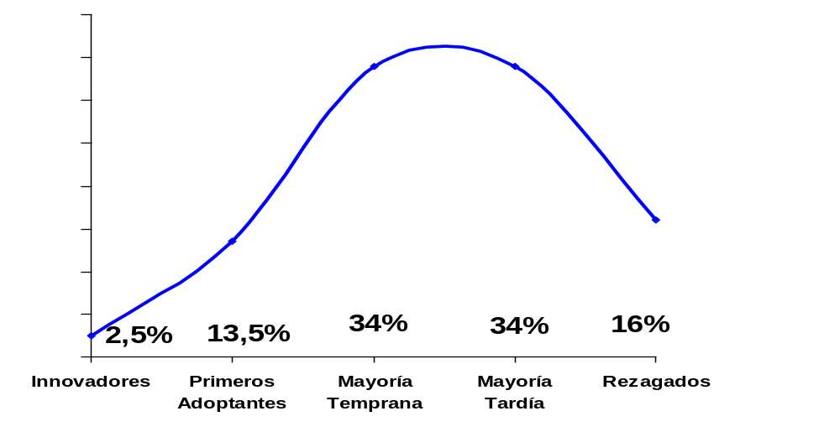
Positioning. Adoption Process.
Not every person who adopts a product does it at the same time. His profile is different depending on this moment.
Source: TNS - 2007
Adventurers.
Take risk.
Cosmopolitan.
High incomes
Opinion leaders.
Self-confidents
Sceptic,
Insecure people
Precarious Economy
Rural areas
Followers
Notes:
Initial advertising should target the first adopters. Followers are fundamental to consolidate the product.

Slide 11
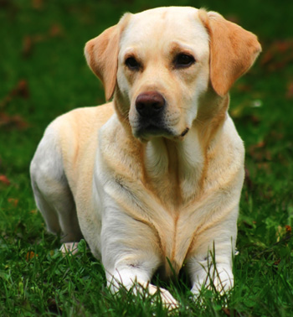

Internal positioning. Portfolio Matrix. Boston Consulting Group
DILEMMA STAR
DOG CASH COW
(lower) Relative market participation (greater)
?
(lower) Market Growth (greater)

Slide 12
Positioning. The brand
It is a name, term or symbol that tries to identify the product, in order to differentiateit from the competitor's
Brand Composition: Name + Logotype.
Logotype purpose ---> making the brand, product or company easier to distinguish and remember
Desired qualities
  Simple, Brief, easy to remember and pronounce.
  Suggesting some of the qualities or benefits of the product.
  Distinctive.
  Able to be registered.
  Exportable.
  Evocative.

Slide 13
Positioning. Management and development of the product. Portfolio as a guarantee of positioning
DEPTH
PRODUCT LINE 1 1a 1b 1c
PRODUCT LINE 2 2a 2b
PRODUCT LINE 3 3a 3b 3c 3d
PRODUCT LINE 4 4a 4b 4c
LENGTH: WIDTH X DEPTH
CONSISTENCE: Coherence among the different lines
  WIDTH
Notes:
LINE: Group of products. Closely related because they perform similar function, are sold to the same group of consumers, channels,…
It will be too short if we increase b’s when increase the number of products, and viceverse. Be aware about Share vs profitability.

Slide 14

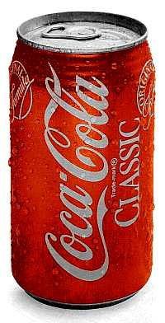

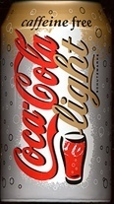
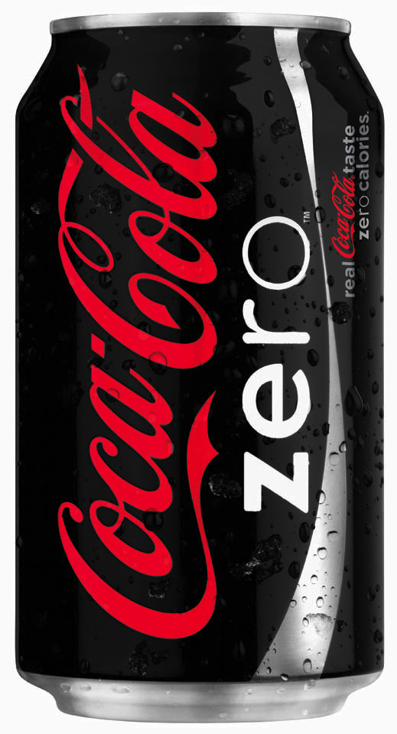
Example: Product line extension: Deepening …..

Slide 15


Example: Extension by widening the category range

Slide 16

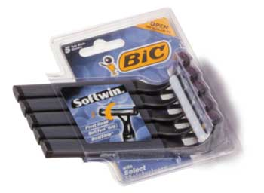
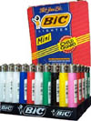
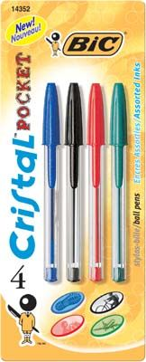
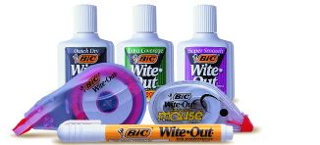
Example: Extension by widening the category range

Slide 17
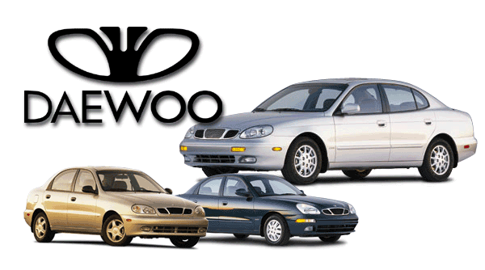
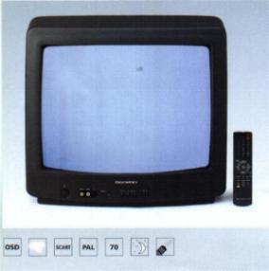
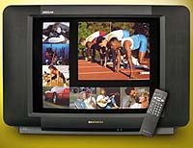
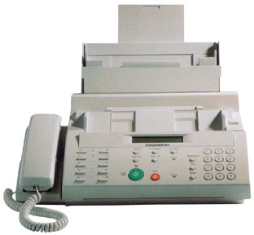

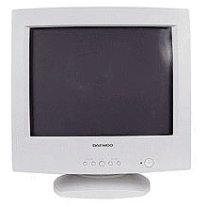
A different approach: A common company brand without a necessarily shared positioning

Slide 18
Marketing mix

Slide 19
Marketing
1.- Strategic Marketing:
    Segmentation Strategy.
    Positioning Strategy.
2.- Tactical marketing or marketing Mix: The 4 P's. Product, Price, Place, Promotion.

Slide 20
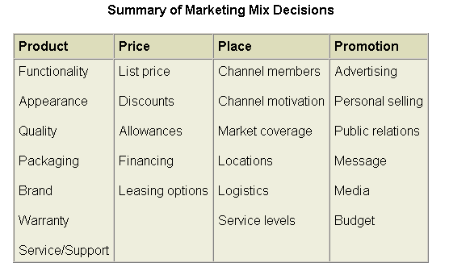
Summary of possible marketing mix decisions

Slide 21
Marketing Mix: distribution (Place), how do I provide the product / service to my customers?
Notes:
We have already segmented and quantified the market. Now we have to check how to provide the product / service to the customers.

Slide 22
Concept of distribution
  One of the 4 p’s of marketing policies.
Distribution is about providing the finished products or services to the potential customers so that the client can decide whether to buy or not. To do that, the products have to be carried to the precise place, in an enough large quantity and at the opportune moment. Logistics is a tool for the marketing distribution policies.
Notes:
It is one of the four p’s (place) of marketing (we are starting to define our marketing plan). Comment the definition. It is very important because it delimits several things. Comment also the competitive advantages. Talk about examples of competitive advantages based on distribution. Do not confuse with logistics, which is a tool for distribution.

Slide 23
Channels of distribution.
These are the different paths followed by the products or services from their initial production stage till their final consumption place or buying decision location. Along the different paths, we can find some intermediaries providing support and value to the distribution tasks.
Notes:
Distribution and intermediary concept.

Slide 24
Distribution policy.
GOALS.
Having the product available when the customer wants to buy.
Having the product available where the consumer wants to buy.
In order to fulfil these goals, we have to decide which typology of SALES FORCE we will have. In order to do that, we need an answer for these questions:
  Number of points of sale.
  Their geographical location.
  The type of distribution channel (external or internal).
Notes:
Aspects that we have to define in our marketing strategy which are extremely important.

Slide 25
Distribution policy.
The channel choice will affect:
1. The pace of production
2. The control of the distribution
3. The brand image
CRITERIA FOR CHOOSING THE CHANNEL:
  The required quality of the distribution work,
  The possibility to perform the distribution together with other products.
  The control required by the company.
  The loss of information about the market.
  The need of using training.
  Type of remuneration.
  The cost that represents.
Notes:
Comment the effects of the channel choice and the criteria and elements to take into account when performing this choice.

Slide 26
Example of a distribution channel in a foreign country (automotive industry)
Final consumer.
Vehicle acquisition
Factory.
Finished vehicle.
Destination
country
importer
Dealer
Agent
Final consumer.
Reparation and
maintenance
Notes:
A classical example.

Slide 27
Example of a competitive advantage search using the distribution channel (automotive industry)
Factory,
Finished vehicle
El Corte Inglés
(ManyCars)
Final consumer.
Vehicle acquisition
Destination
country importer
Agent
Final consumer.
Reparation
and maintenance
Cut out intermediary
Cut out intermediary
Value not provided
to the customer
Notes:
El Corte inglés. An example of a new business based on a curious competitive advantage based on distribution.

Slide 28
Types of distribution channels (1)
Consumption companies
  They usually have long distribution channels with several intermediaries.
Industrial or professional services companies
  Short distribution channels.
Notes:
Types of channels.

Slide 29
Types of distribution channels(2)
Associations of wholesalers
Central Purchase Associations
Centralized specialized markets
Cooperatives of retailers
Franchises
…....
Notes:
Types of channels for the commercial distribution. Comment each one.

Slide 30
Marketing Mix: Product, features to give to the product to achieve positioning
Notes:
We have already segmented and quantified the market. Now we have to check how to provide the product / service to the customers.

Slide 31
Product
We have to think about what modifications or complements have to be performed in the product/service in order to achieve the level of sales proposed in the chosen Market segment.
Among the main aspects to be considered, we should highlight these ones:
The presentation. Is a key element for many customers as well as for the impulse buy. The package, wrapping, labelling,...
The name or brand which are easy to pronounce, remind and representative are factors that makes selling easier and enhance the fidelity of customers.
The warranties are another argument for selling, if we decide to offer warranties, it is paramount to estimate their cost for the future business.
After-sales services require a larger organization.
The evolution and development of the product have to be anticipated previously in order to save future expenses.
Notes:
All these elements have to be present at the product policy. Revise each one.

